Slide 1
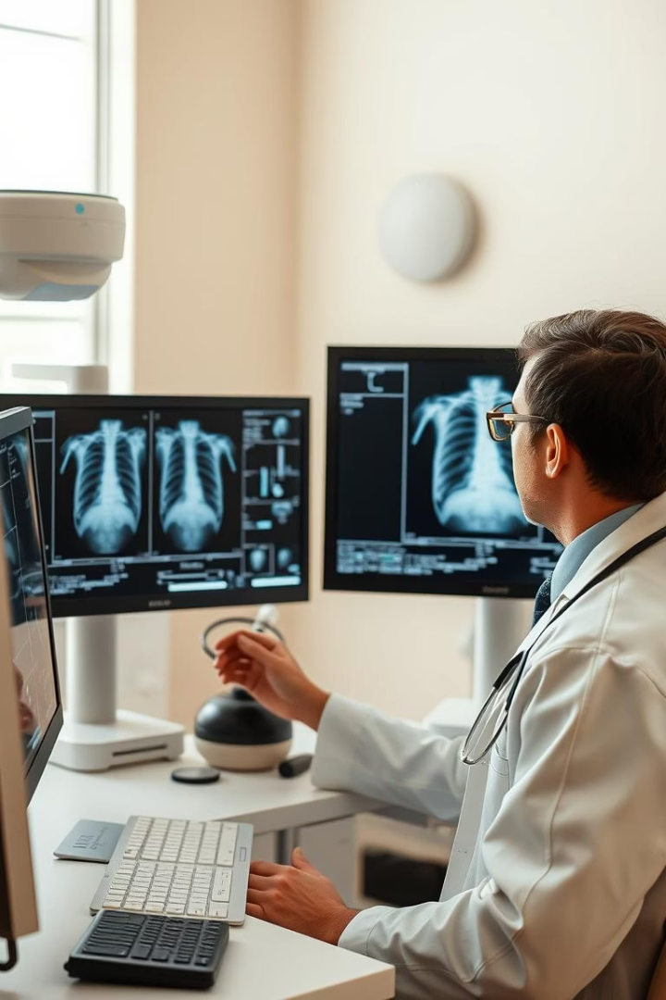
Chest X-ray Disease Detection
Detecting Pneumonia using Machine Learning

Slide 2

Team Names
Ahmed Maher
Mohamed Khalifa
Abdalla Mohamed
Mayar Alaa
Ghada Nasser
Ahmed Essam

Slide 3





Agenda
Problem & Motivation
Pneumonia detection challenges
Objectives
Goals of our ML solution
Dataset & Preprocessing
X-ray image preparation
Results & Impact
Performance and applications

Slide 4
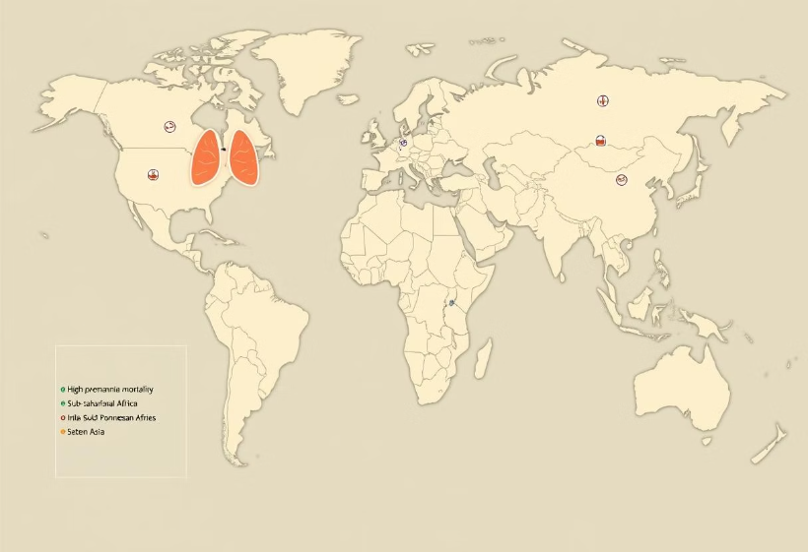
What is Pneumonia & Why Pneumonia Detection?
What is Pneumonia?
Lung infection causing fluid-filled air sacs
Why Pneumonia Detection?
Global Impact: Pneumonia causes 2.5 million deaths annually and threatens young children most.
Challenges: Manual diagnosis is slow and error-prone, especially in rural areas lacking radiologists.
AI offers faster, scalable detection to save lives worldwide.

Slide 5
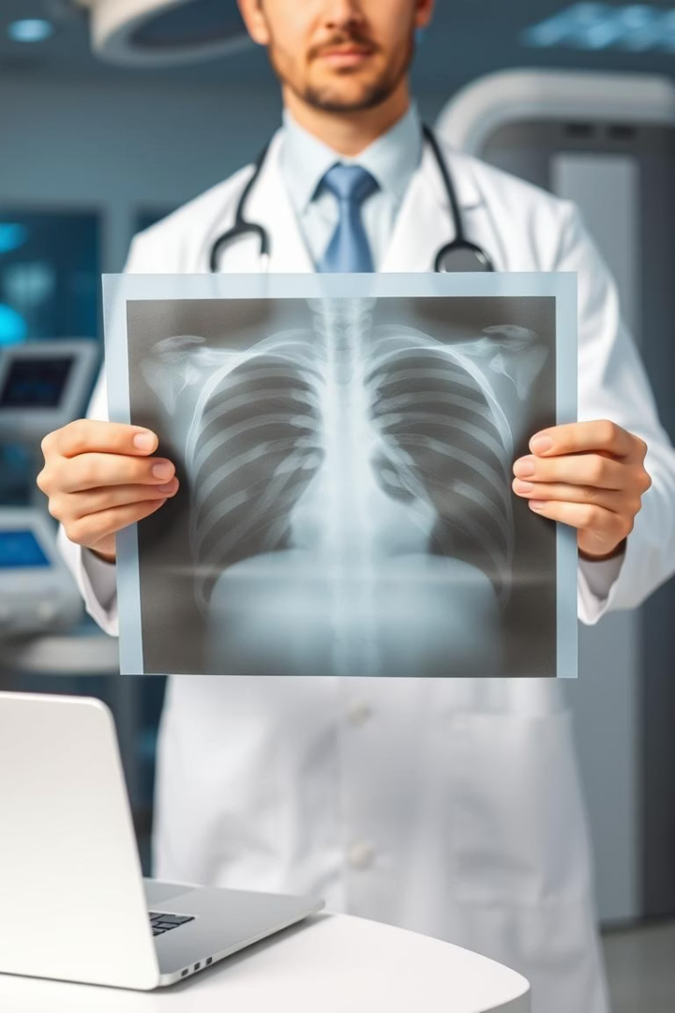




Motivation
Global Health Crisis
Major cause of mortality worldwide
Vulnerable Populations
High mortality in children and elderly
Resource Gaps
Radiologist shortage in rural areas
Time-Critical
Need for fast, automated diagnostic tools

Slide 6






Objectives
Save Lives
Improve early detection rates
Enhance Diagnosis
Faster, more accurate results
Automate Classification
ML-powered X-ray analysis

Slide 7
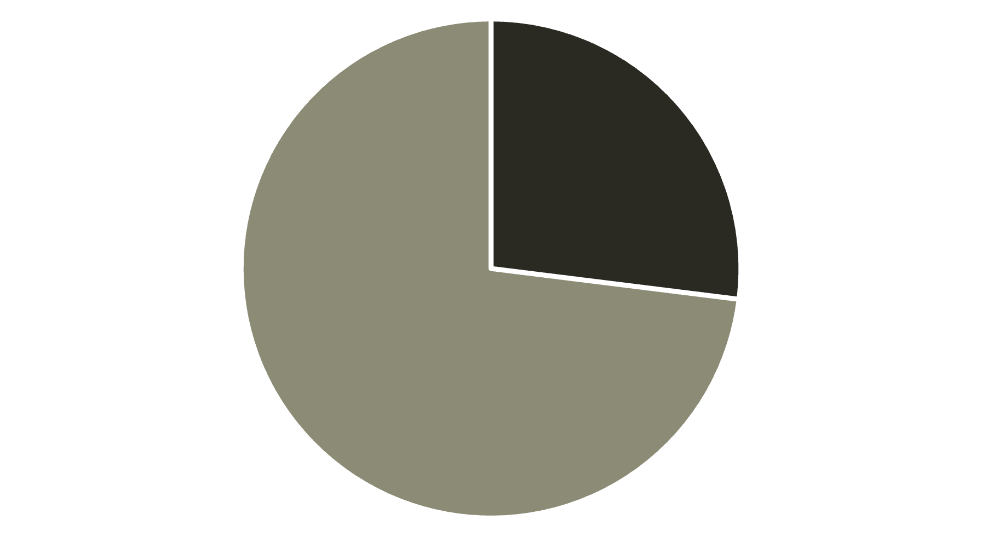
Dataset Overview
Normal
Pneumonia
Source: Paul Mooney's Kaggle Dataset
linke : https://www.kaggle.com/datasets/paultimothymooney/chest-xray-pneumonia
Total: 5840 X-ray images across 2 classes (0=Normal, 1=Pneumonia)

Slide 8
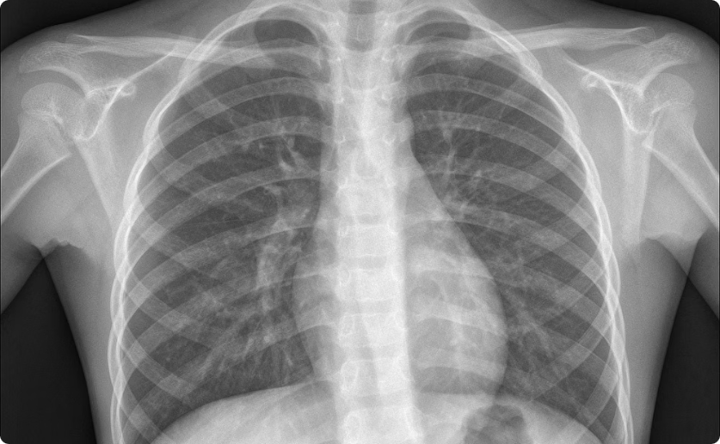
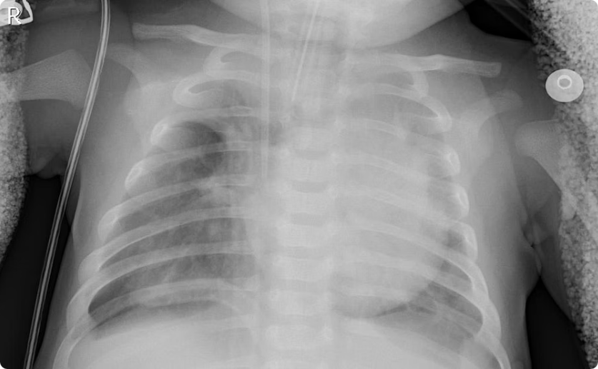
Sample Images
Normal X-ray
Pneumonia X-ray
Clear lung fields, defined diaphragm
White opacities, infiltrates in lung fields
Key visual differences help train our model to distinguish between classes

Slide 9

Data Preprocessing
Image Standardization
1
Resize to 128x128, convert to grayscale
2
Label Encoding
Binary classification: 0=Normal, 1=Pneumonia
Normalization
3
MinMaxScaler for consistent pixel values

Slide 10
Feature Extraction Method
We applied manual feature extraction using HOG (Histogram of Oriented Gradients).
This captures edge and texture patterns relevant to pneumonia detection.
Flattened pixel values were combined with HOG features for richer data representation.
1
Step 1: Calculate HOG Features
2
Step 2: Flatten Pixels
3
Step 3: Combine Features
Convert the 2D image array into a 1D vector for model input.
Concatenate HOG and pixel features for a comprehensive representation.
Extract gradients to capture local shapes and textures in X-ray images.

Slide 11
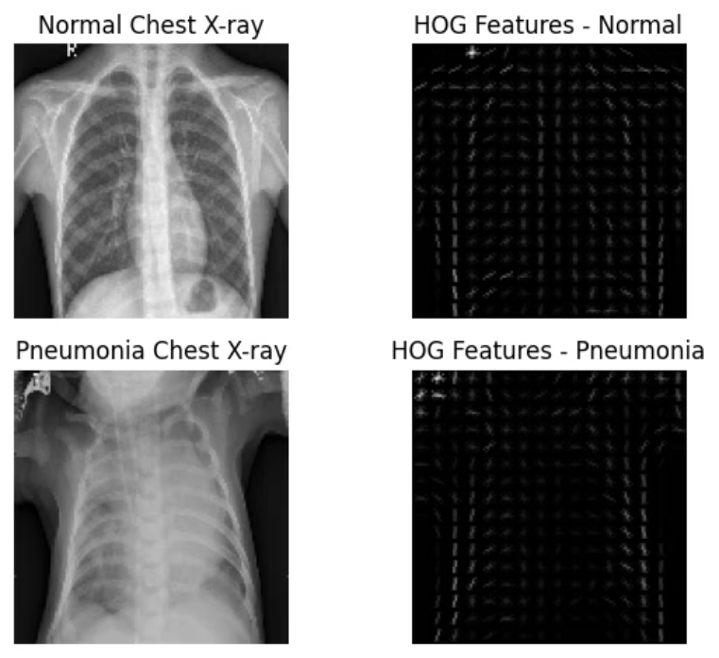
Sample Images
Before
After

Slide 12
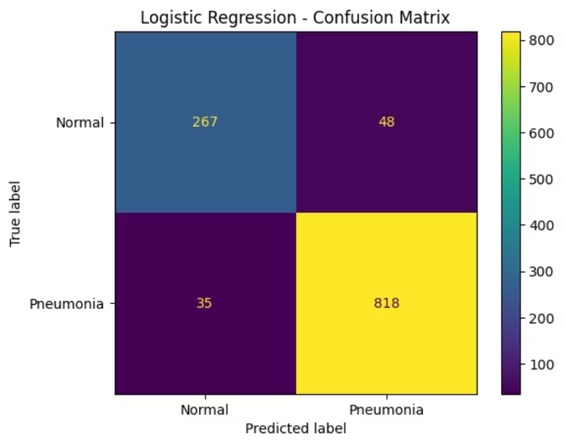
Feature Extraction (HOG) & Filtering Results
Results below reflect model performance before any additional preprocessing steps such as scaling, PCA, or feature selection.
Logistic Regression Accuracy
0.9289
Confusion matrix illustrates predictions versus actual labels for Normal and Pneumonia classes.

Slide 13
Data Preprocessing Steps
Feature Selection & Balancing
Dimensionality Reduction
Select top features using mutual information and balance classes with SMOTE technique.
Scaling
Apply PCA to compress feature vectors and reduce overfitting and computational cost.
Normalize pixel and HOG features using MinMaxScaler for consistent data ranges.

Slide 14



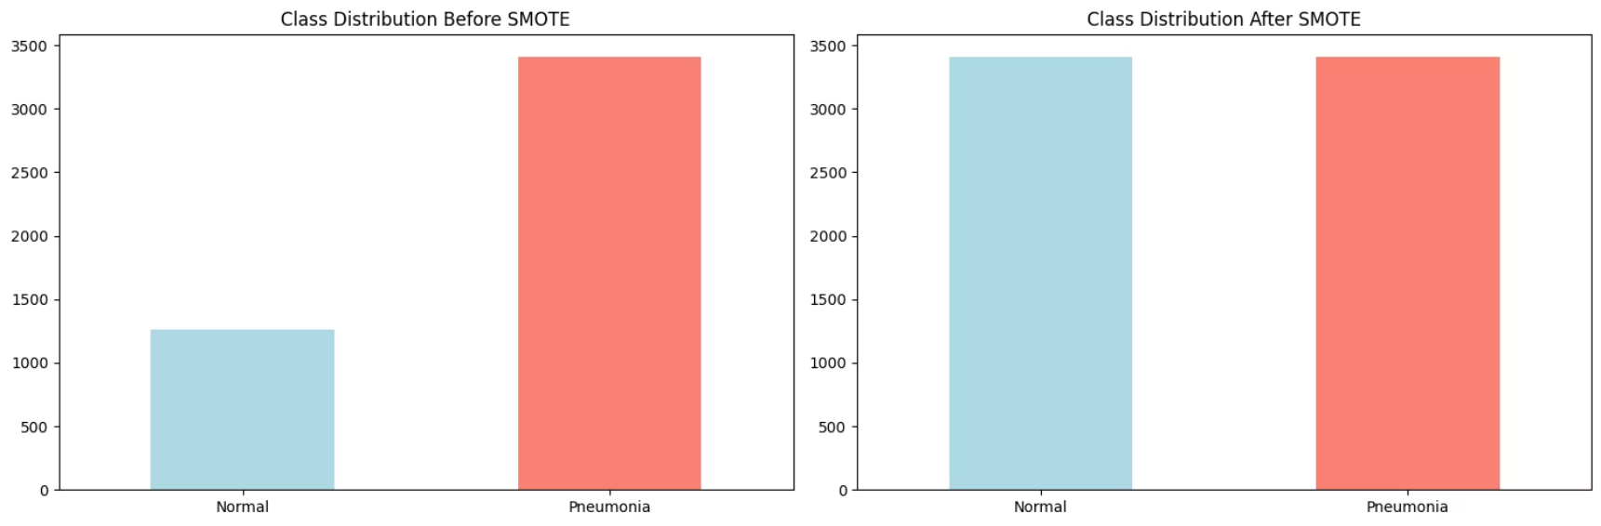
Handling Class Imbalance
Class Imbalance Issue
SMOTE Technique
Better Model Training
Pneumonia cases outnumber normal cases by a ratio of 3 to 1.
Synthetic Minority Oversampling Technique (SMOTE) used to balance classes.
Balancing improves model fairness and reduces bias towards majority class.

Slide 15
Models Used for Pneumonia Detection
1
K-Nearest Neighbors (KNN)
Simple, instance-based classifier with 10 neighbors.
2
Logistic Regression
Robust linear model with 1000 iterations limit.
3
Random Forest
200 trees, depth capped at 10 for balance.
4
Support Vector Machine (SVM)
Radial kernel, moderate complexity with C=1.
5
Naive Bayes
Probabilistic classifier for quick baseline results.
6
Decision Tree
Depth-limited to 10, interpretable decision paths.
7
XGBoost
Advanced ensemble method with 300 estimators.

Slide 16
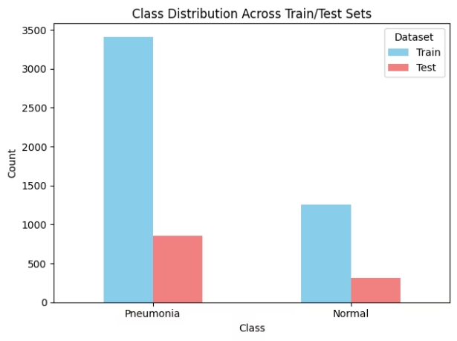
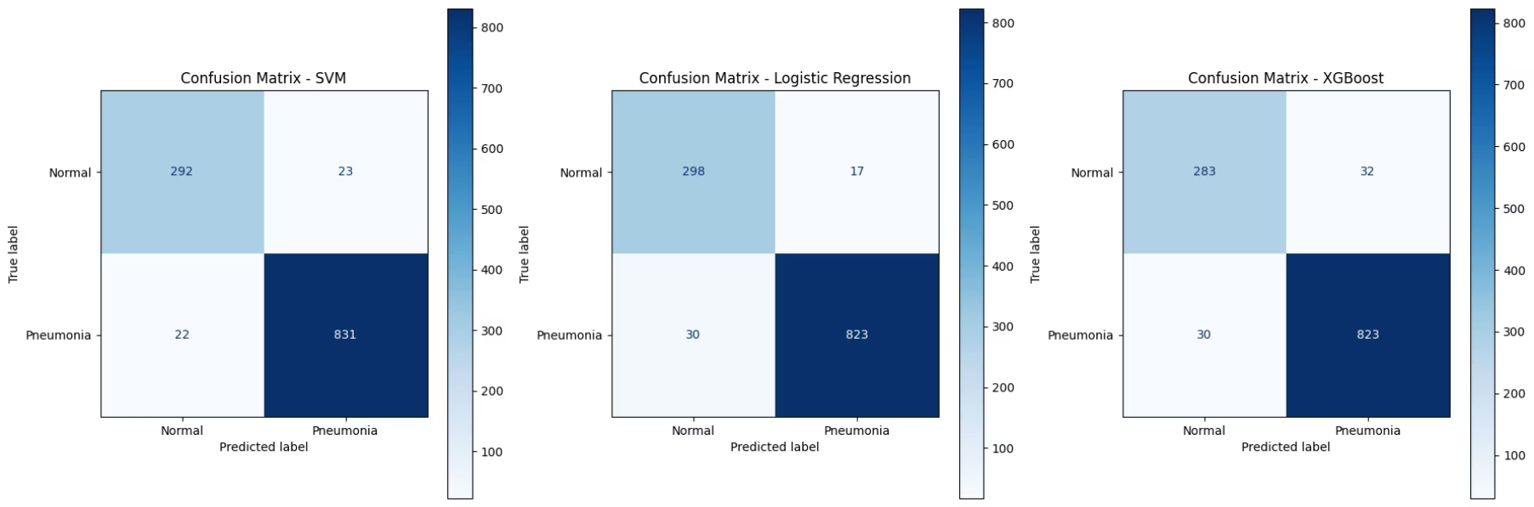
Model Evaluation
Train/Test Split: 80/20 for robust model validation.
Key Metrics: Accuracy, Precision, Recall, and F1-score assess performance.
Visualization: Confusion matrix to analyze prediction errors and successes.
Tools: Utilized classification_report and ConfusionMatrixDisplay for detailed analysis.

Slide 17



Ensemble Models Overview
2
Bagging Classifier
Uses multiple Logistic Regression models to reduce variance and improve stability.
Voting Classifier
Combines Logistic Regression, SVM, and XGBoost with hard voting for better accuracy.
1
Stacking Classifier
Builds layered models stacking Logistic Regression, SVM, and XGBoost with a logistic meta-learner.
3

Slide 18
Model Accuracy Comparison
Model
Accuracy
Stacking Classifier
0.9606
SVM & Voting Classifier
0.9598
Logistic Regression
0.9563
Bagging Classifier
0.9555
Random Forest
0.9461
XGBoost
0.9435
Decision Tree
0.8793
KNN
0.8724
Naive Bayes
0.7474

Slide 19
Classification Report Summary
Precision
Recall
F1-Score
Support
Normal
0.929
0.908
0.918
315
Pneumonia
0.966
0.974
0.970
853
Accuracy
0.956
—
Macro Avg
0.947
0.941
0.944
1168
Weighted Avg
0.956
0.956
0.956
1168

Slide 20
Tech Stack Overview
Programming: Python and Jupyter Notebook as primary coding environments
Key Libraries: sklearn for ML, numpy and pandas for data handling
Specialized Tools: xgboost for boosting, imblearn for imbalance, scikit-image for image processing
Visualization: matplotlib and cv2 for plotting and image manipulation
Platforms: Kaggle for datasets, GitHub for version control, Google Colab for collaboration

Slide 21
Conclusion
Strong Potential of Machine Learning
Effective Without Deep Learning
Impact on Healthcare
Automated detection can save time, reduce costs, and save lives.
Machine learning significantly aids accuracy in medical image analysis.
Our project achieved high accuracy using traditional ML techniques.

